Slide 1
HW0
This lecture assumes you have completed homework 0. If you have not done so yet, complete HW0 and then come back.

Slide 2
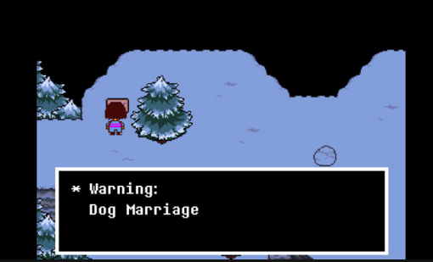
Further Notes for Webcast Viewers
Any time I’m live coding, I advise you to pause frequently and try to anticipate my next move. You’ll probably learn more by trying to guess what I’m going to do rather than just watching me do it.

Slide 3
Announcements
Project 0 is out! Due next Friday, September 4th at 11:59 PM.
To be completed on your own, no partners.
Though do take advantage of office hours!
Lab 1 is due Friday, January 29, to allow for additional time for people joining the class late or with significant setup issues.
The Live Q&A on Friday 1/22 at 2 PM assumes you have watched this lecture.
Feel free to ask any questions about the course!
… or if everyone is interested, we can also talk about literally anything else.

Slide 4
Announcements 2
Ed tips:
Make sure to search for an answer before posting.
Instructor answers are intentionally rate limited. We don’t want you guys to get reliant on us for answers, and want you to talk to each other.
Make sure your question has enough information for someone to help.
Good question: https://imgur.com/a/6wUIR
Screenshots! Examples of what the anonymous poster has tried. And a followup explaining the resolution for other students.
Starting with project 0: If there’s a chance a staff member might need to look at your code, make sure your most recent code is pushed to github and provide a link in your post.

Slide 5
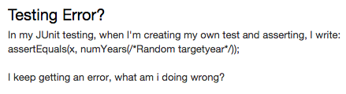
Announcements 3
Example of a bad question.
Doesn’t specify when the error is happening or what it is.
No discussion of what the student has already tried.

Slide 6
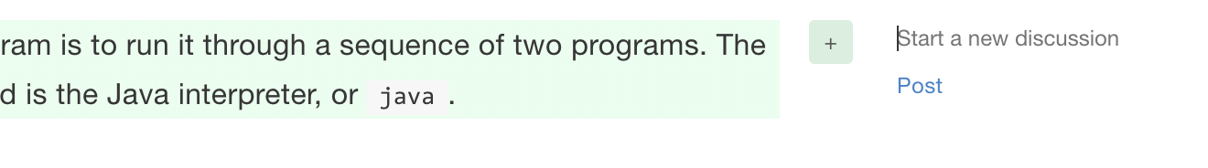
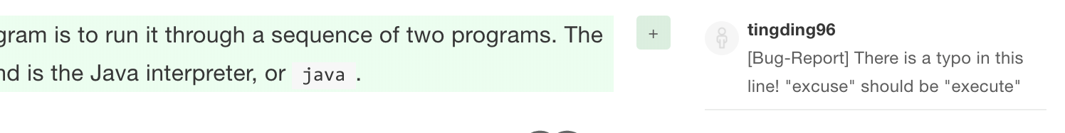
Announcements 4
If you spot any typos or errors in the online textbook (of which there are surely many), you can comment directly on the book using the “Start a New Discussion” button:
It’s especially helpful if you include “[Bug-Report]” in your comment, e.g.:

Slide 7
CS61B: 2020
Lec 2: Using and Defining Classes
Compilation
Defining and Instantiating Classes
A Closer Look at Static

Slide 8
Compilation

Slide 9
Compilation
The standard tools for executing Java programs use a two step process:
This is not the only way to run Java code.
Compiler
Interpreter
stuff
happens
Hello.java
javac
Hello.class
java
Why make a class file at all?
.class file has been type checked. Distributed code is safer.
.class files are ‘simpler’ for machine to execute. Distributed code is faster.
Minor benefit: Protects your intellectual property. No need to give out source.
You can learn more about all this in 61C and particularly 164.
Note: .class files are easily reversible into similar looking Java files.

Slide 10
Defining and Instantiating Classes

Slide 11
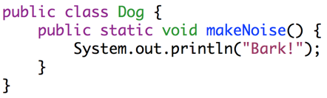
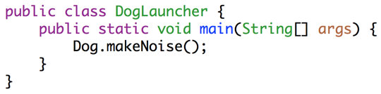
Dog
Must be in the “CLASSPATH”
As we saw last time:
Every method (a.k.a. function) is associated with some class.
To run a class, we must define a main method.
Not all classes have a main method!
public class Dog {
public static void makeNoise() {
System.out.println("Bark!");
}
}
Can’t be run directly, since there is no main method.
public class DogLauncher {
public static void main(String[] args) {
Dog.makeNoise();
}
}
Calls a method from another class. Can think of this as a class that tests out the Dog class.

Slide 12
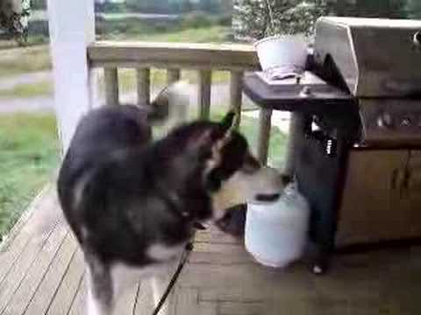

Object Instantiation
Not all dogs are equal!
Notes:
12m30s without announcements or questions

Slide 13
A not so good Approach
We could create a separate class for every single dog out there, but this is going to get redundant in a hurry.
public class MayaTheDog {
public static void makeNoise() {
System.out.println("arooooooooooooooo!");
}
}
public class YapsterTheDog {
public static void makeNoise() {
System.out.println("awawawwwawwa awawaw");
}
}

Slide 14
Object Instantiation
Classes can contain not just functions (a.k.a. methods), but also data.
For example, we might add a size variable to each Dog.
Classes can be instantiated as objects.
We’ll create a single Dog class, and then create instances of this Dog.
The class provides a blueprint that all Dog objects will follow.
Side note: For E7/MATLAB folks, if you’ve ever gotten an axis using gca(), this is similar. Each axis has the same properties, e.g. they all have xTicks, etc.
These instances are also called ‘objects’

Slide 15
Defining a Typical Class (Terminology)
public class Dog {
public int weightInPounds;
public Dog(int startingWeight) {
weightInPounds = startingWeight;
}
public void makeNoise() {
if (weightInPounds < 10) {
System.out.println("yipyipyip!");
} else if (weightInPounds < 30) {
System.out.println("bark. bark.");
} else {
System.out.println("woof!");
}
}
}
Instance variable. Can have as many of these as you want.
Constructor (similar to a method, but not a method). Determines how to instantiate the class.
Non-static method, a.k.a. Instance Method. Idea: If the method is going to be invoked by an instance of the class (as in the next slide), then it should be non-static.
Roughly speaking: If the method needs to use “my instance variables”, the method must be non-static.

Slide 16
Instantiating a Class and Terminology
public class DogLauncher {
public static void main(String[] args) {
Dog smallDog;
new Dog(20);
smallDog = new Dog(5);
Dog hugeDog = new Dog(150);
smallDog.makeNoise();
hugeDog.makeNoise();
}
}
Declaration of a Dog variable.
Instantiation of the Dog class as a Dog Object.
Instantiation and Assignment.
Declaration, Instantiation and Assignment.
Invocation of the 150 lb Dog’s makeNoise method.
The dot notation means that we want to use a method or variable belonging to hugeDog, or more succinctly, a member of hugeDog.

Slide 17
Arrays of Objects (assuming you’ve done HW0!)
To create an array of objects:
First use the new keyword to create the array.
Then use new again for each object that you want to put in the array.
Example:
After code runs:
Dog[] dogs = new Dog[2];
dogs[0] = new Dog(8);
dogs[1] = new Dog(20);
dogs[0].makeNoise();
Creates an array of Dogs of size 2.
Yipping occurs.
dogs =
Dog of size 8 | Dog of size 20
0
1

Slide 18
Static vs. Instance Members

Slide 19
Static vs. Non-static
Key differences between static and non-static (a.k.a. instance) methods:
Static methods are invoked using the class name, e.g. Dog.makeNoise();
Instance methods are invoked using an instance name, e.g. maya.makeNoise();
Static methods can’t access “my” instance variables, because there is no “me”.
Non-static
Static
public void makeNoise() {
if (weightInPounds < 10) {
System.out.println("yipyipyip!");
} else if (weightInPounds < 30) {
System.out.println("bark. bark.");
} else { System.out.println("woof!"); }
}
public static void makeNoise() {
System.out.println("Bark!");
}
This method cannot access weightInPounds!
maya = new Dog(100);
maya.makeNoise();
Invocation:
Dog.makeNoise();
Invocation:

Slide 20
Why Static Methods?
Some classes are never instantiated. For example, Math.
x = Math.round(5.6);
Sometimes, classes may have a mix of static and non-static methods, e.g.
Much nicer than:
Math m = new Math();
x = m.round(x);
public static Dog maxDog(Dog d1, Dog d2) {
if (d1.weightInPounds > d2.weightInPounds) {
return d1;
}
return d2;
}

Slide 21
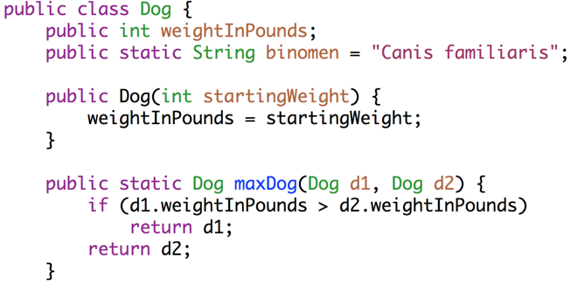
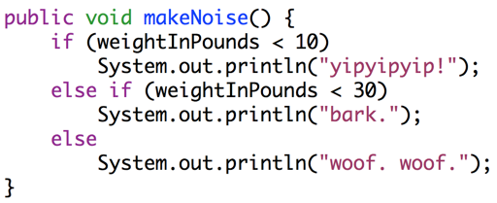
Static vs. Non-static
A class may have a mix of static and non-static members.
A variable or method defined in a class is also called a member of that class.
Static members are accessed using class name, e.g. Dog.binomen.
Non-static members cannot be invoked using class name: Dog.makeNoise()
Static methods must access instance variables via a specific instance, e.g. d1.

Slide 22
Question: Will this program compile? If so, what will it print?
public class DogLoop {
public static void main(String[] args) {
Dog smallDog = new Dog(5);
Dog mediumDog = new Dog(25);
Dog hugeDog = new Dog(150);
Dog[] manyDogs = new Dog[4];
manyDogs[0] = smallDog;
manyDogs[1] = hugeDog;
manyDogs[2] = new Dog(130);
int i = 0;
while (i < manyDogs.length) {
Dog.maxDog(manyDogs[i], mediumDog).makeNoise();
i = i + 1;
}
}
}
< 10:
yip
< 30: bark
>=30:
woof
Notes:
26 minutes not including questions or announcements

Slide 23
Answer to Question
Won’t go over in live lecture. Use the visualizer to see the solution at this link.
Or if you’re watching this video and can’t find the slides, the link is: http://goo.gl/HLzN6s

Slide 24
Managing Complexity with Helper Methods

Slide 25
Managing Complexity with Classes and Static Methods
Some obvious questions arise:
Why does Java force us to use classes?
Why have static methods at all?
The reason: To take choices away from the programmer.
Fewer choices means fewer ways to do things.
Example: Declaring a method static means you can’t use any instance variables in that method.
Fewer ways to do things often means less complexity.

Slide 26
Managing Complexity More Generally
IMO, a good foundational computer science course should primarily teach you to properly manage complexity.
This philosophy drives nearly all aspects of this 61B’s design.
Let’s cover one important idea that you’ll want to be using all throughout the course: helper methods.
Using helper methods lets you formalize the decomposition of large problems into small ones.
By focusing mental effort on a single task, there’s less room to make mistakes.

Slide 27
Goal: largerThanFourNeighbors
Suppose we want to write a method:
public static Dog[] largerThanFourNeighbors(Dog[] dogs)
This method will return a new array that contains every Dog that is larger than its 4 closest neighbors, i.e. the two on the left and the two in the right. If there are not enough neighbors, i.e. you’re at the end of the array, then consider just the neighbors that exist. For example:
Input: Dogs with size [10, 20, 30, 25, 20, 40, 10]
Returns: Dogs with size [30, 40].
30 is greater than 10, 20, 25, and 20.
40 is greater than 25, 20, and 10.

Slide 28
Goal: largerThanFourNeighbors
Suppose we want to write a method:
public static Dog[] largerThanFourNeighbors(Dog[] dogs)
If input Dog sizes are [10, 15, 20, 15, 10, 5, 10, 15, 22, 20], what will be the size of the Dogs returned?
[20]
[20, 22]
[20, 22, 20]

Slide 29
Goal: largerThanFourNeighbors
Suppose we want to write a method:
public static Dog[] largerThanFourNeighbors(Dog[] dogs)
If input Dog sizes are [10, 15, 20, 15, 10, 5, 10, 15, 22, 20], what will be the size of the Dogs returned?
[20]
[20, 22]
[20, 22, 20]

Slide 30
Writing largerThanFourNeighbors
Now let’s try it out!
Our first attempt will be all part of one big function.
The code will be messy, hard to reason about, hard to debug.
By formally decomposing into helper methods, we will make our code easier to read and understand, and easier to debug when things go wrong.

